Slide 1
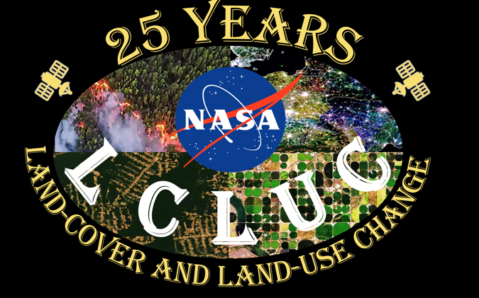
Land-Cover/Land-Use Change (LCLUC) Program
Garik Gutman,
NASA Headquarters
Manager, LCLUC Program
Fires
Urban changes
Deforestation
Agriculture
April 2016
Notes:
For the selected Fire image the source is: https://www.reuters.com/news/picture/wildfires-rage-across-siberia-idUKRTX7KU6E
"An aerial view shows a forest fire in Krasnoyarsk Region, Russia July 17, 2020. Sweltering heat and dry weather have helped wildfires spread across Siberia and into the boreal forest and tundra that blanket northern Russia. Julia Petrenko/Greenpeace/Handout via REUTERS"
Deforestation in Rondonia, Brazil
Pivotal irrigation in Kansas, USA
Night lights RGB change in economy over Moldova and Ukraine in 1990s (blue)

Slide 2
Internal NASA Linkages
Carbon Cycle and Ecosystems Focus Research Area
Terrestrial Ecosystems
Program
Ocean Biology
Program
Biodiversity
Program
Applications
Program
Carbon Management
Coastal Management
Water Management
Agri. Management
Land-Cover/Land-Use
Change Program
Atmospheric
Composition
Focus Area
Radiation
Science
Water and Energy Cycle
Focus Research Area
Terrestrial Hydrology

Slide 3
25 Years of External Interactions: National
U.S. Global Climate Research Program (USGCRP)
LULCC Interagency Working Group
Our Changing Planet
NRC review of land-use models
U.S. Geological Survey (USGS)
Landsat program
USGS science projects’ support
Global Land Surveys (Landsat-based)
U.S. Department of Agriculture (USDA) and U.S. Forest Service (USFS)
HARVEST program
USDA, USFS science projects’ support
U.S. Agency for International Development (USAID)
SERVIR
PEER (Partnerships for Enhanced Engagement in Research)

Slide 4
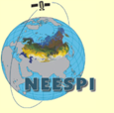
International External Linkages:
GOFC-GOLD
START Inc.
Implementation Teams
Regional Networks
FUTURE
EARTH
Global Land Program
NEESPI/NEFI
Future Asia
CEOS/GEO
GFOI
GEOGLAM
Regional Initiatives
SAFARI (South Africa)
LBA (Amazon)
NEESPI (Northern Eurasia)
MAIRS (Monsoon Asia)
SARI (South/Southeast Asia)
SERVIR
SARI (Asia)
Latin America
Africa
LCLUC
ESA
MuSLI Products
JAXA
Radar Studies
GISTDA
Capacity Building
EARSeL-LULC
Special Interest Group
Japan: NIES
EU: Academia

Slide 5
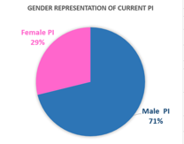
25-yr Program stats:
>300 projects
~50 ongoing
>800 researchers
>20 post-docs
>50 grads
>1000 publications
24%
30%
70%
http://lcluc.umd.edu

Slide 6
Uniqueness of the LCLUC Global Science Program
Socio-economic component: an integral part of the projects
impacts of changes in human behavior and economy on LCLUC
impacts of LCLUC on society
adaption to climate change of land-use systems
a mandatory part of all LCLUC proposals, except MuSLI
Remote sensing component: Multi-Source Land Imaging (MuSLI) at medium or higher resolution
Regional Initiatives: focus on Hotspots
Capacity Building/Education component

Slide 7
LCLUC Science Team Meetings in DC Area
2007: Climate/Carbon
2008: Joint CC&E Focus Area/Arctic
2009: LCLUC impacts on climate
2010: GLS LCLUC products
2011: 15th Anniversary (review)
2011/9: Joint CC&E Focus Area/ Ag
2012: Urban
2013: Wetlands
2014: Urban
2015: Joint CC&E FA/LCLUC Modeling
2016: 20th Anniversary/Industr. Forests
2017: Mountains & MuSLI
2018: SARI-1: South Asia/MuSLI
2019: SARI-2: SE Asia/Caucasus
2020: MuSLI (virtual)
2022: 25th (Silver) Anniversary/AFOLU
2023: Joint CC&E FA/Hot spots/ECS

Slide 8
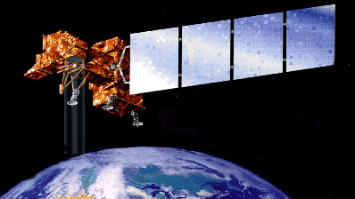
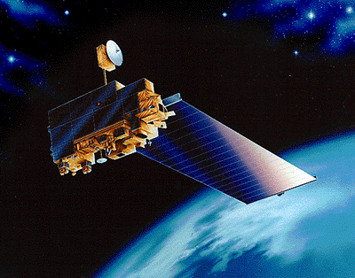
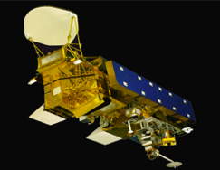
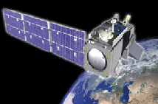
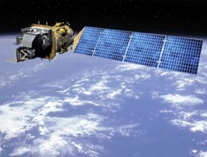
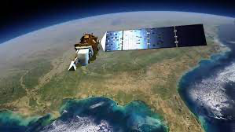
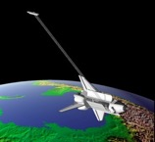
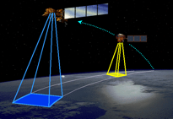
NASA LCLUC-Relevant Missions
in the Past 25 years
Systematic Missions - Observation of Key Earth System Interactions
Landsat 5 & 7 3/1/84 & 4/15/99
Terra 12/18/99
Aqua 5/3/02
Suomi-NPP 10/28/11
Landsat 8 2/11/13
Landsat 9 9/27/21
ASTER
MODIS
VIIRS
Exploratory Missions –
Exploration of Specific Earth System Processes
and Demonstration of Technologies
International Space Station (ISS)
ShuttleRadar Topography Mission SRTM
Earth Observing EO-1
ECOSTRESS (thermal IR)
GEDI (Lidar)
DESIS (Hyperspectral)
active
ALI (predecessor of Landsat-8)
Deployed in 2018
2/11/02-2/22/02
Space Shuttle Endeavour
Hyperion – first hyperspectral in space
11/21/00-3/30/2017

Slide 9
25-Year of Global LCLUC Products: Summary of Achievements
The program has
provided the basis for monitoring, reporting and verification (MRV) of agricultural, forest-, and other land-use (AFOLU) change, including wetlands and urban in the context of the implementation of Carbon Treaties
created the means to undertake periodic, continuous global assessments of Land-Cover and Land-Use Change
quantified rapid changes in the urban built environment, forest cover, agriculture and wetlands globally – focus on Hotspots
provided the primary science rationale for the Landsat Mission and, more general, Sustainable Land Imaging (SLI)
developed global Landsat-based products
prototyped new, continental-to-global scale data products with multi-source land imaging (MuSLI) approaches; developed a Harmonized Landsat-Sentinel (HLS) dataset

Slide 10
NASA LCLUC-USGS
Global Land Survey (GLS) Data Sets
An Exemplary Synergistic Use of Global Landsat Time Series Prior to its Free Availability
For global assessments of land-cover change (e.g., FAO’s FRA)
Global cloud-free 30-m mosaic
geocorrected Landsat-5, -7 datasets centered on 1975, 1990, 2000, 2005, 2010
EO-1 ALI data over small islands
1 scene per epoch at greenness peak
Description of GLS published in P&RS, 2008 (Gutman et al.) with a cover image
Available for download via GLOVIS/EarthExplorer at USGS free of charge
Assessment of the NASA–USGS Global Land Survey (GLS) datasets published in RSE, 2013 (Gutman et al.)
Progression of fires scars in central Canada

Slide 11
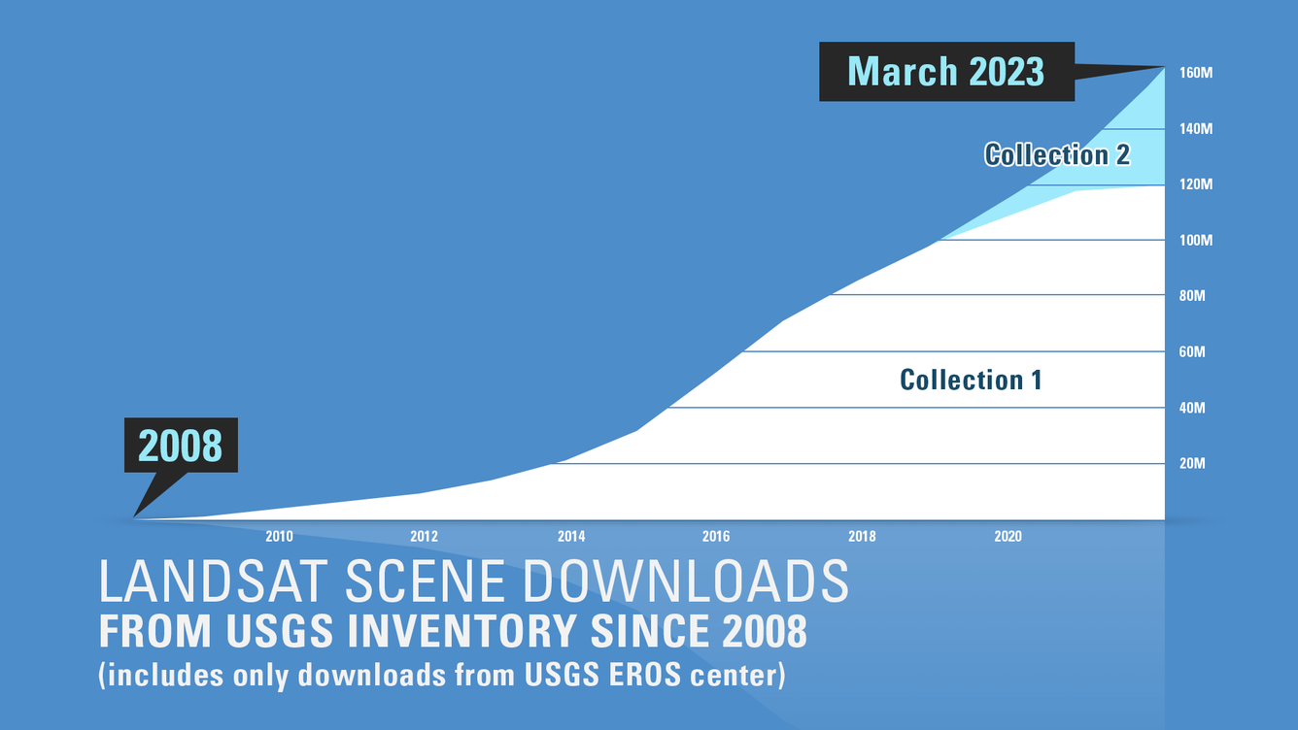
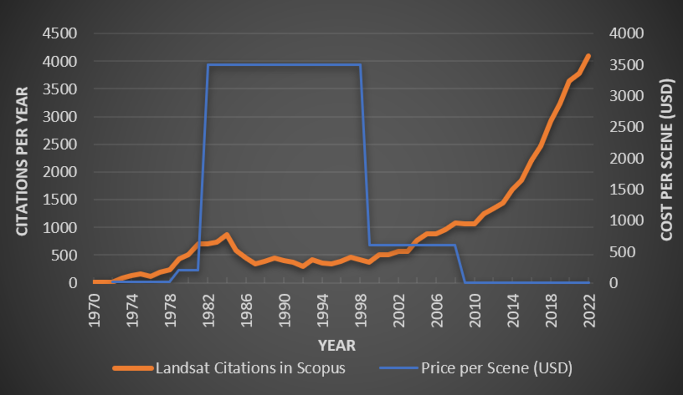
15th Anniversary of the New Era in Landsat Data Utilization
The 100 millionth Landsat scene was recently downloaded from the EROS archive, marking a major milestone for a policy shift that opened the door to previously impossible wide-scale research projects and generated billions of dollars in returns worldwide.
April marked the 15-year anniversary of the USGS announcement to ‘open’ the Landsat archive at the USGS Earth Resources Observation and Science (EROS) Center, making all Landsat data available to download at no charge for users worldwide
Barb Ryan,
former Associate Director of Geography for USGS,
and (more recently) former Secretariat-Director for the Group on Earth Observations (GEO)

Slide 12
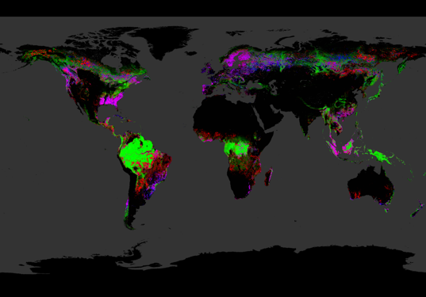
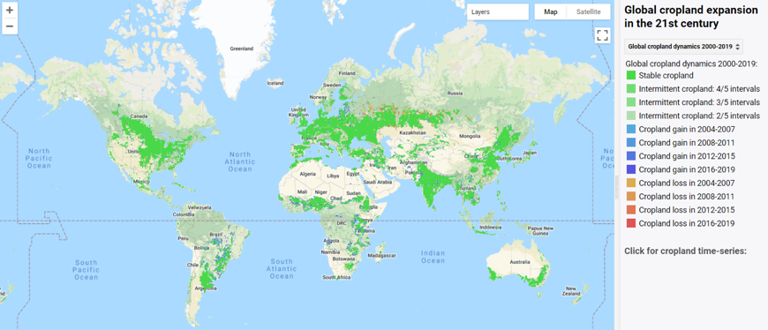
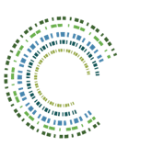
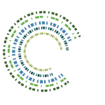
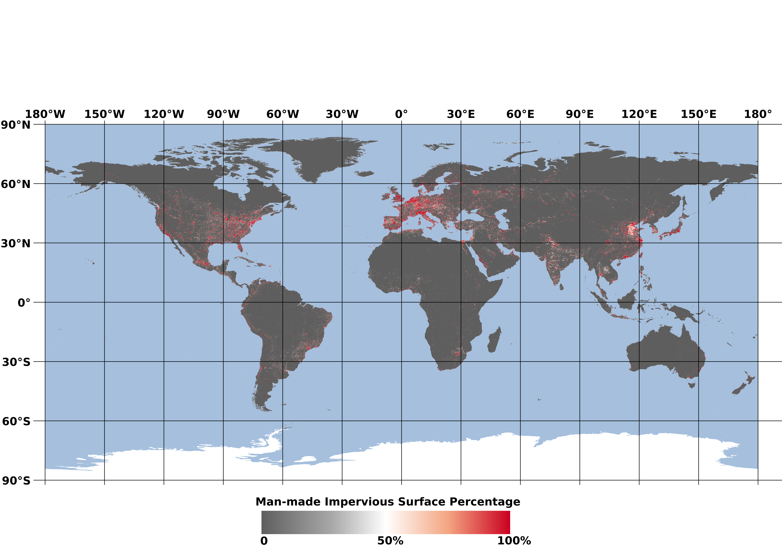
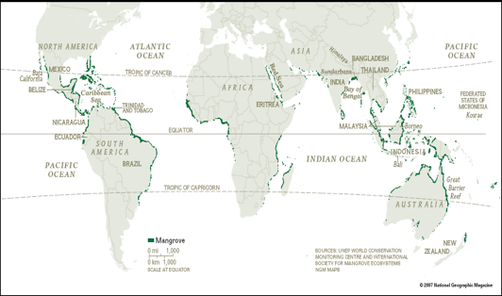
Landsat-Derived LCLUC Global Products
Tree Cover Extent and
Forest Loss and Gain: 2000-2014
Global Cropland Extent and Change 2000-2020
Hansen et al., Science 2013
Potapov et al., Nature Food, 3, pages19–28 (2022)
Mangroves Extent
Impervious Surfaces and Settlements Extent
Eric Brown de Colstoun, NASA GSFC
Cheng Huang, U. Maryland
2017
Chandra Giri, USGS → EPA
Remote Sens. 2021, 13, 563 https://doi.org/10.3390/rs13040563

Slide 13
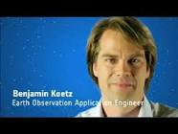
Combining optical and microwave data: Landsat + Sentinel 2 + Sentinel 1
Multi-Source Land Imaging (MuSLI)
Sentinel-2a: launched in Jun 2015
Sentinel-2b: launched in Mar 2017
Sentinel-1a: launched in Apr 2014
Sentinel-1b: launched in Apr 2016
Sentinel-1b: set for launch in 2023
Landsat-7: launched in Apr 1999
Landsat-8: launched in Feb 2013
Landsat-9: launched in Sep 2021
Merging Sentinel-2 and Landsat data streams could provide < 5-day coverage required for Ag monitoring
Both sensors have 10-30m coverage in VNIR-SWIR
Satellite orbits complementary
Landsat-8 & -9 8 days
Sentinel-2a & 2b 5 days
Global ~3 day
Merging in Sentinel-1 radar data provides all-weather microwave observations
Jeff Masek, NASA GSFC
MuSLI Project Scientist
Landsat-9 Project Scientist
Landsat-7
Landsat-8
Landsat-9
Sentinel-2a
Sentinel-2b
Sentinel-1a
Sentinel-1b
MuSLI ESA Project Scientist
Benjamin Koetz,
2013
2014
2015
2016
2017
2018
2019
2020
2021
2022
2023
MuSLI Solicitations: LCLUC-2014 (merging Landsat and Sentinel-2); LCLUC-2017 (incl. Radar data); LCLUC-2020 (incl. VHR data); LCLUC-2023 (incl. IR data and all of the above)

Slide 14
Harmonized Landsat-Sentinel (HLS) Dataset
Collaborative NASA-led effort
NASA/USGS Landsat 8 data and the ESA Sentinel-2A and -2B data
Two provisional publicly available HLS products
Landsat 30m and Sentinel 30m atmospherically-corrected surface reflectance datasets
Global 2020 -> 2015 processing to July of 2018 of S2 has been completed and is availabl (Global 2018 -> 2015 processing wil be completed this summer)
Available for download through NASA’s LP DAAC and Earthdata Search
The first major Earth science dataset in NASA’s EOSDIS hosted fully in the commercial cloud
Also available through the EOSDIS Global Imagery Browse Services for interactive exploration using the NASA Worldview data visualization application
Harmonized surface reflectance seamless dataset
Like it is coming from a single platform
Temporal resolution better than Landsat alone
Will greatly improve studies of fast processes
Spatial resolution much better than daily MODIS (or VIIRS) images
Full HLS global coverage every 2-3 day on a common 30-m grid
Complementary, co-registered Landsat 8 TIRS surface temp. data
For land management activities, fields, individual forests, urban areas
Already used in the development of a new vegetation seasonal cycle dataset available through LP DAAC: the Multi-Source Land Imaging (MuSLI) Land Surface Phenology Yearly North America product (under LCLUC Program)
Collaborative Effort
IMPACT, NASA MSFC (Ensure compliancy of data formats, metadata, file names; code implementation; production stream to get data to LP DAAC for distribution
NASA-USGS LP DAAC (Preparing Landsat data and the atmospheric correction code; archiving/distributing)

Slide 15
Global LANDSAT-GEDI Forest Canopy Height Product An Exemplary Passive-Active RS Data Synergy
Global Forest Canopy Height: 2019
Integration of the GEDI lidar forest structure measurements and Landsat analysis-ready data time-series
Potapov et al. 2020, RSE

Slide 16
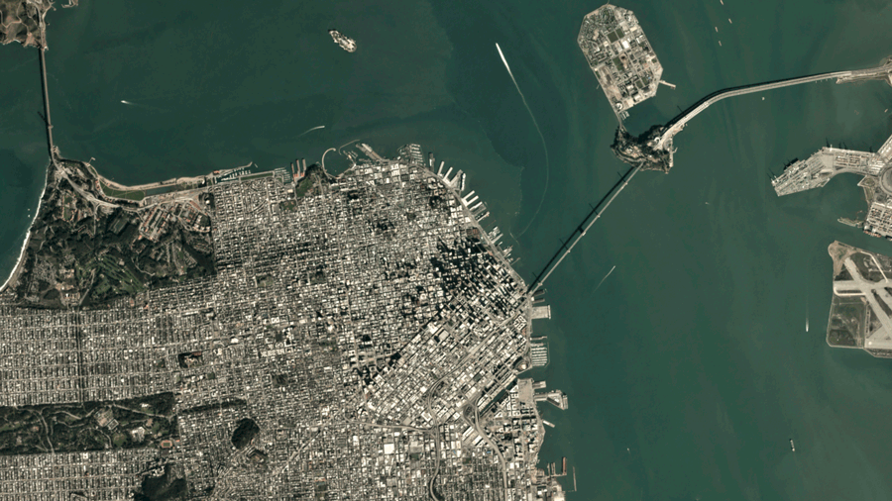
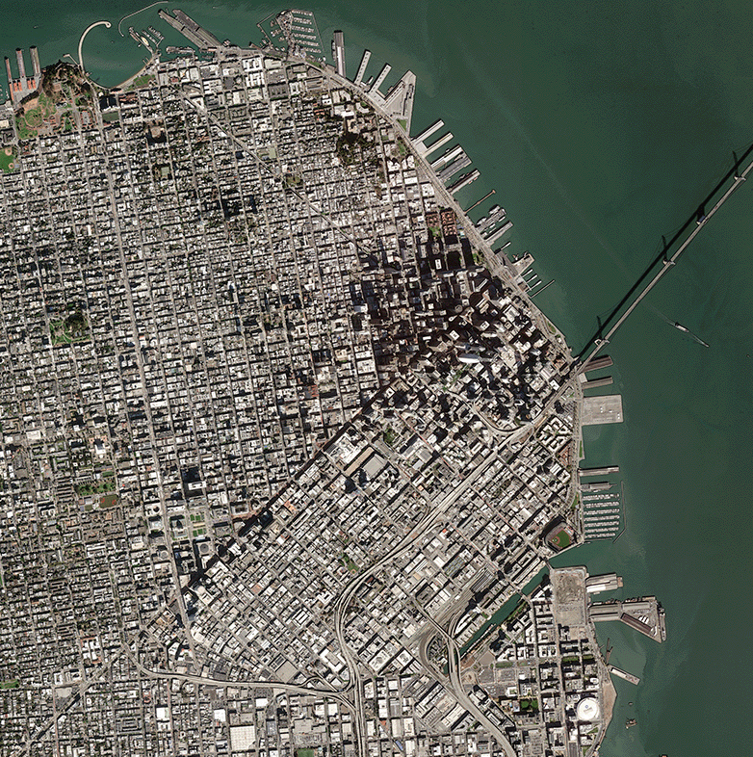
Zooming-in: Using Very High Resolution Data
Commercial satellites offer images at fine spatial scale and high temporal resolution
The first NASA Data Buy 2003 – Ikonos
Planet Labs constellation (>200 sats) acquire daily images of the Earth with 3-m resolution
Maxar (Digital Globe, WorldView) with 1m resolution
NASA Commercial Smallsat Data Acquisition (CSDA)
Limited Planet datasets are available for free at Universities
Wall-to-wall VHR data over tropics purchased by the government of Norway (to tackle tropical deforestation)
Special Issue in Remote Sensing (2020) on applications of VHR data in LCLUC studies

Slide 17
Hotspots of Land Use
Indrani Kommareddy
LCLUC Program
Meghavi Prashnani
LCLUC Program

Slide 18
25 Years of Regional Programs: Summary of Accomplishments
The program has
advanced scientific analysis to areas of the globe where LCLUC is taking place and provided insight into the various impacts of these changes
examined the underlying drivers of land-use change including socio- economic, political, institutional aspects in diverse regions of the globe
evaluated the role of satellite data in initiating projections of future regional land-use change
built broad networks of international scientists that routinely utilize NASA data to monitor regional land-use change

Slide 19
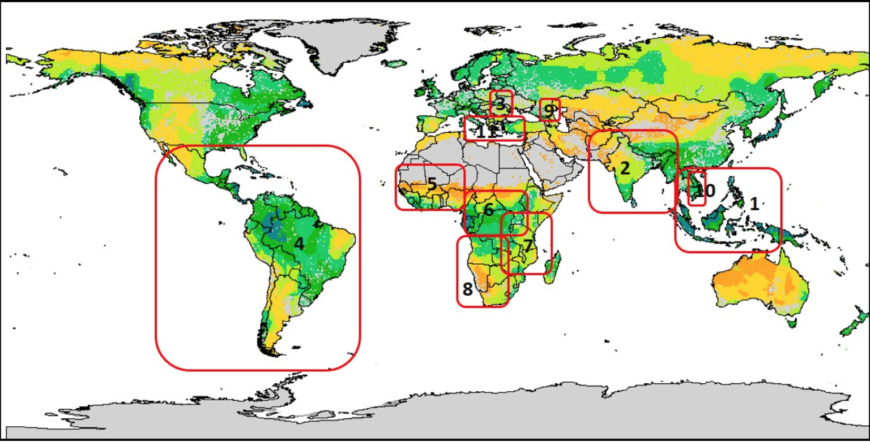
LCLUC – Global Program
with Worldwide Capacity Building:
GOFC-GOLD Regional Networks
1. Southeast Asia Regional Research and Information Network (SEARRIN)
2. South Asia Regional Information Network (SARIN)
3. South Central European Regional International Network (SCERIN)
4. Red Latinoamerica de Teledeteccion e Incendios Forestales (RedLaTIF)
5. West African Regional Network (WARN)
6. Observatoire Satellital des Forets d’Afrique Central (OSFAC)
7. Miombo Network (MIOMBO)
8. Southern Africa Fire Network (SAFNET)
9. Caucasus Regional Information Network (CaucRIN)
10. Mekong Regional Information Network (MekRIN)
11. Mediterranean Regional Information Network (MedRIN)
12. Central Asian Regional Information Network (CARIN)
12

Slide 20
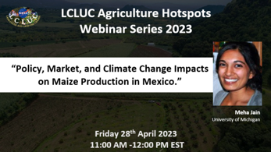
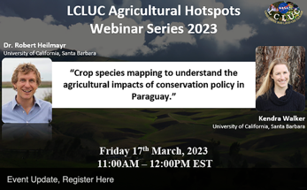
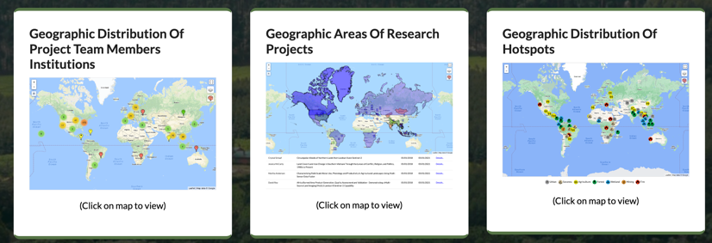
25 Years of Community Outreach
LCLUC Webinars series 2023
Quarterly e-Newsletter
PR, media
Facebook, twitter, linkedin
Website
Mapper
LCLUC Webinars
About 100 presentations
Started in 2014
Total: 18 series
Intensified in 2020
Topical or regional
Close to 2000 individual participants from about 120 countries

Slide 21
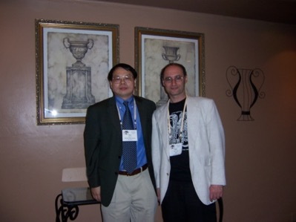
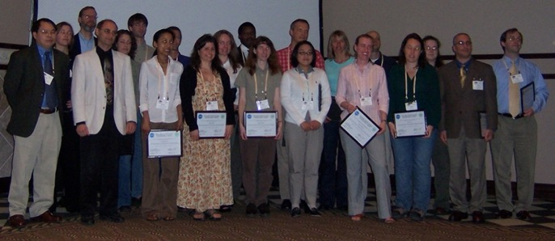
25 Years Supporting Early Career Scientists
Students through Student Fellowships → FINESST calls
New Investigator Program (NIP) calls
LCLUC special calls to bring in young talents to the Program
LCLUC-11 (10 selections)
LCLUC-19 (9 selections)
LCLUC-21 (8 selections)
NASA-Michigan State U. project to support students’ participation in IALE conferences
Allison Leidner, NASA HQ
International Association for Landscape Ecology (IALE) is the worldwide organization for landscape ecologists
Primary mission is to promote global collaborations
Jack Liu, Michigan State U.

Slide 22
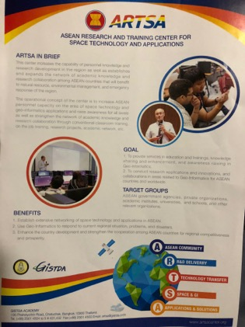
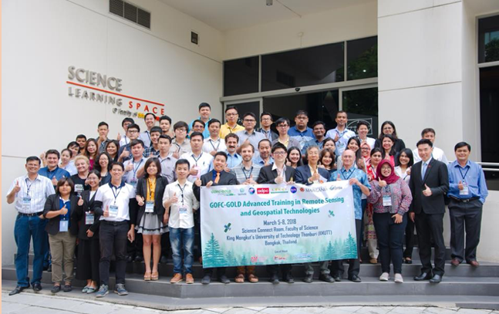
25 years of International LCLUC Capacity Building
Trainings in conjunction with regional LCLUC meetings since 2009
NASA-ESA Trans-Atlantic Training (TAT) for students in Eastern Europe
SARI Trainings in South/SE Asia
In collaboration with SERVIR Hubs in Asia
In collaboration with JAXA, GISTDA
Promoting NASA data, data products and RS methods
Annual TAT sessions since 2013
Francesco Sarti, ESA
Premek Stych, Charles U., Prague
Nancy Searby, NASA HQ
In collaboration with NASA-USAID SERVIR
Krishna Vadrevu, NASA MSFC
Students, 2008
Bangkok, Thailand

Slide 23
Near-Term Plans
Continue foundational Land-Use science of societal relevance and benefit
Integrate satellite data with models and ground observations, such as Google Street View or Google Crop View
Standardize 3D urban satellite products (e.g., urban volume) using SAR, Lidar, and stereo methods, and develop new capabilities in hyperspectral data for studying land use
Develop data fusion methods under MuSLI, including data from the sensors onboard ISS and future missions, e.g., NISAR, Landsat Next, upcoming IR sensors and VHR commercial data, using artificial intelligence/machine learning for fine-scale monitoring
Extend the Harmonized Landsat-Sentinel data set to Landsat 9 and Sentinel 1 data, as well as developing product validation and accuracy assessment methods
Jointly with ESTO, focus on incorporation of land-use data and processes in numerical weather forecast and climate models towards the development of the Land - Earth System Digital Twins
Continue regional international outreach and collaboration

Slide 24
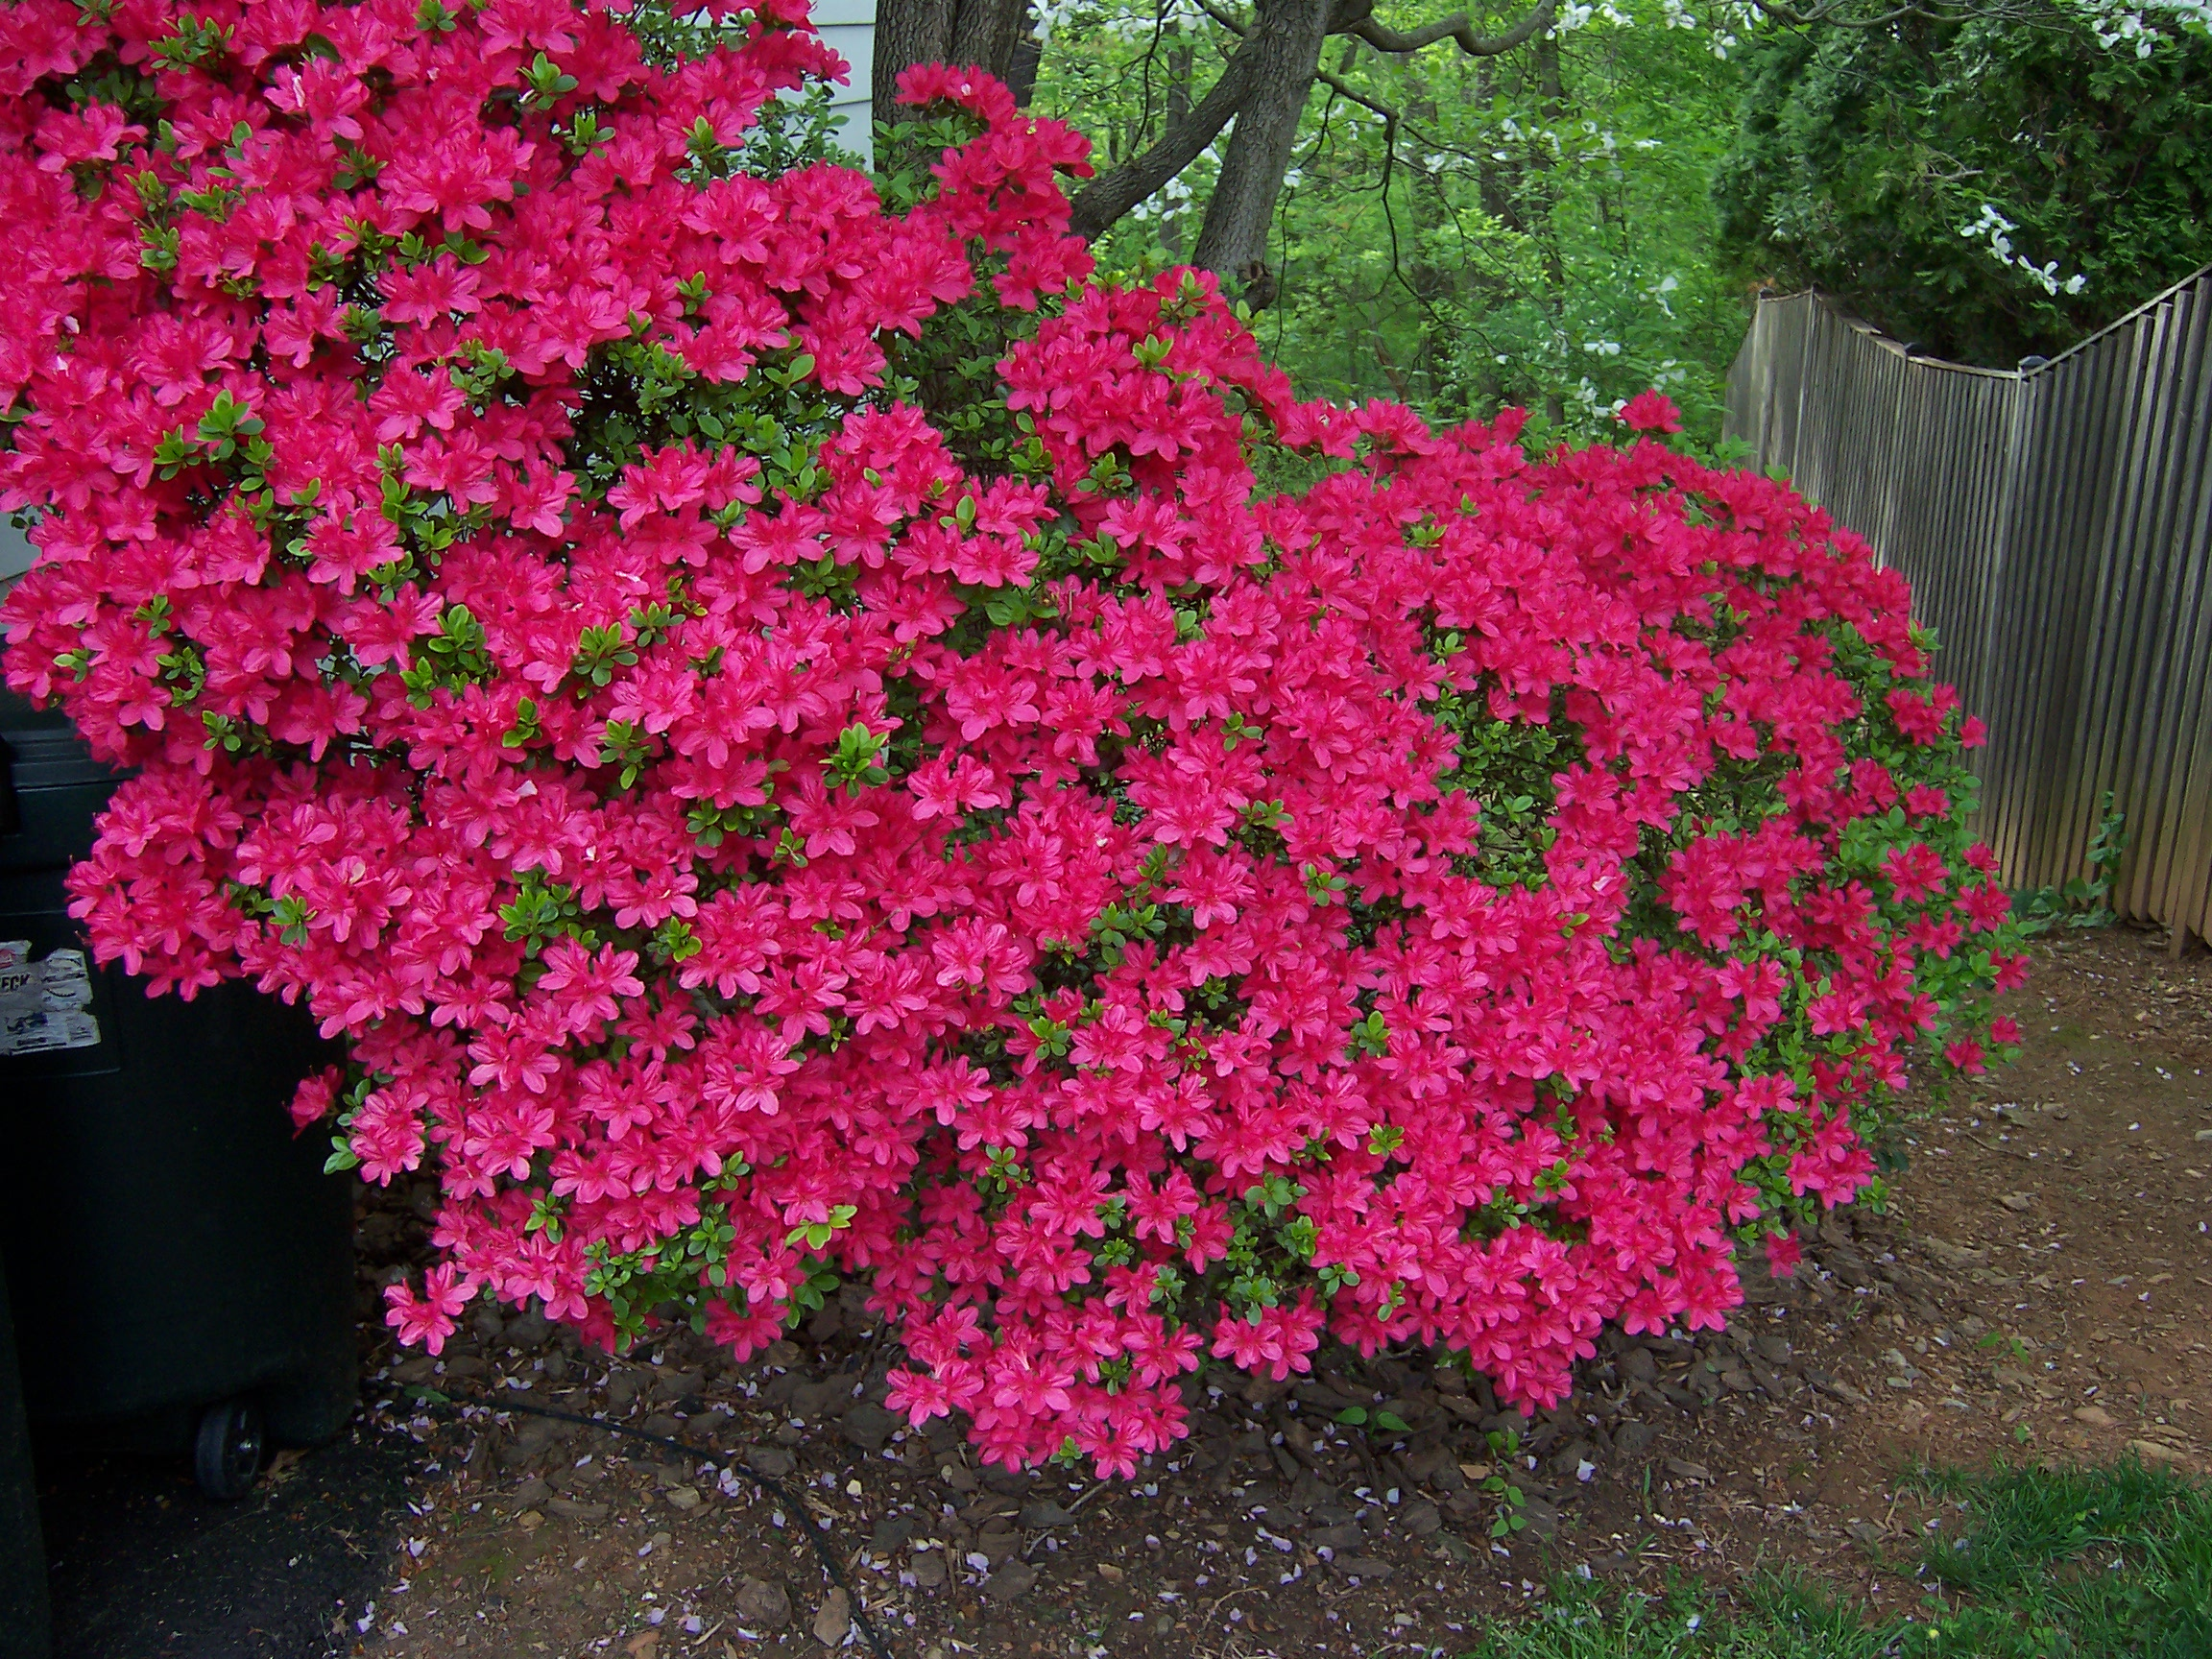
Enjoy
Spring Blossoms

